Slide 1
Texture Atlas Tools for 3dsMax 2015
Jintaek Seo, jintaeks@dongseo.ac.kr
Division of Digital Contents, DSU
June 2017

Slide 2
Purpose
Improve rendering speed of a game by applying a texture atlas to an object
Art resources are controlled by an artist in the modelling stage.

Slide 3
Outline
Concept of the Texture Atlas
Making Atlas 3dsMax Plugin with MaxScript
Making Texture Locator with C#
Making Face Arrange Plugin for 3dsMax
Hurdles in Coding
Demo

Slide 4
Texture Atlas
A texture atlas is a large image containing a collection of sub-images, each of which is a texture for some part of a 3D object.
The sub-textures can be rendered by modifying the texture coordinates of the object's uvmap on the atlas.
It is often more efficient to store the textures in a texture atlas which is treated as a single unit by the graphics hardware.

Slide 5
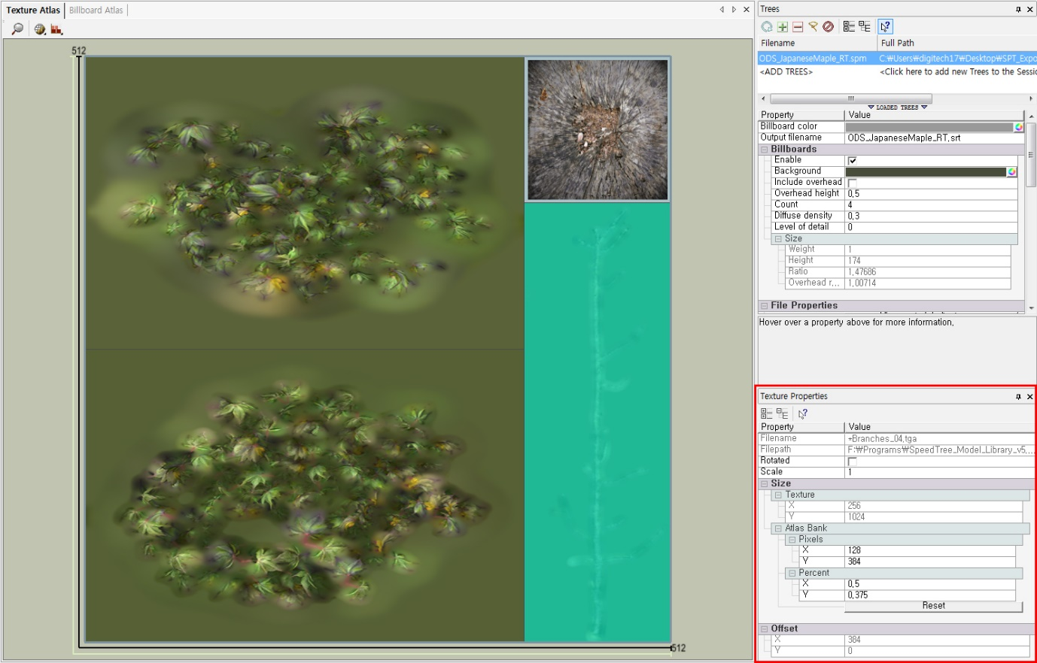
Ex) Atlas tools in SpeedTree
Built-in Atlas tools in SpeedTree

Slide 6
Making Atlas Plugin for 3dsMax
Face Cutting
Add padding

Slide 7
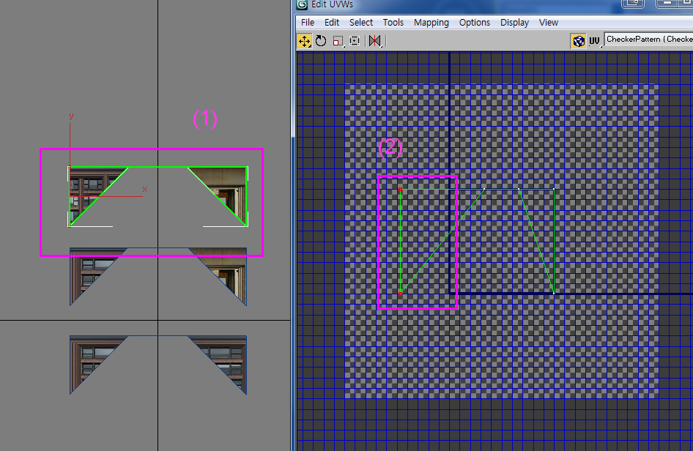
Face cutting and UV settings
UV face(2) of polygon face(1) is out of range [0,1], we need to add UV faces by cutting existing UV faces.

Slide 8
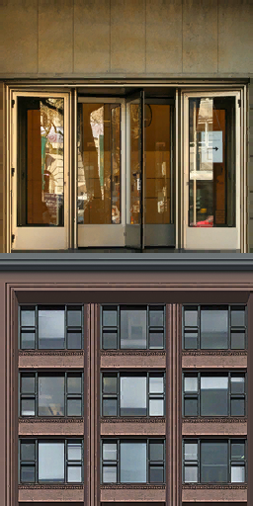
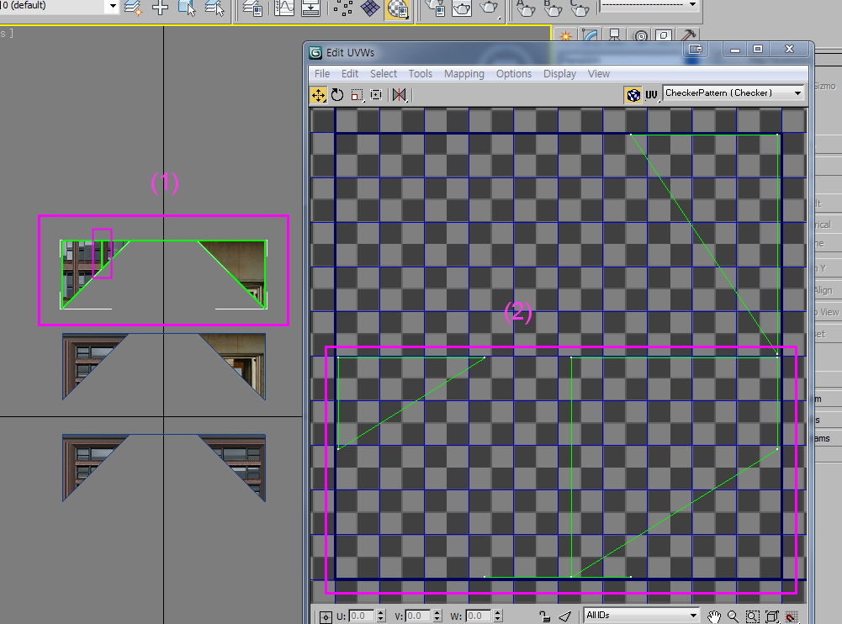
Add UV face and normalize
UV coordinate of UV faces must be normalized to [0,1].
Add a UV face when uv range is out of [0,1].

Slide 9

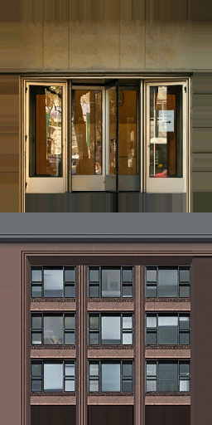
Texture Padding
In the boundary of UV coordinate, adjacent pixels will be sampled.
To prevent invalid sampling, the boundary of each sub texture must be expanded with same colors.
padding 2
padding 22

Slide 10


Making Texture Locator with C#
We used C# with the FreeImage open source library.
http://freeimage.sourceforge.net/
Microsoft Visual Studio C#.

Slide 11
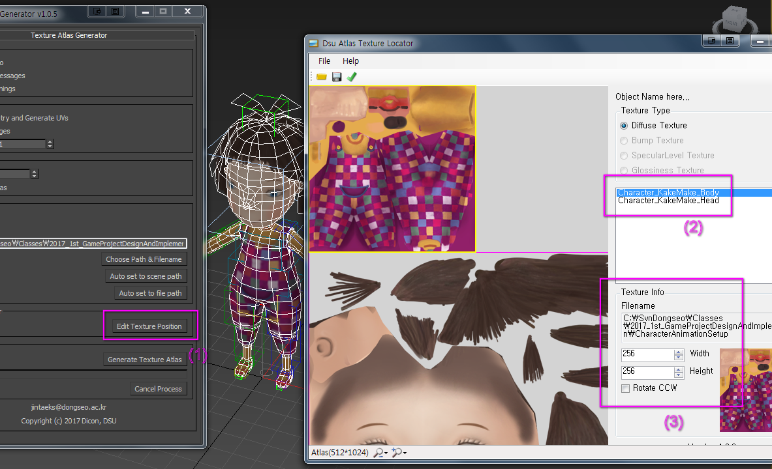
Texture Locator(C#)
Build texture location info and send it to the 3dsMax
It uses the clipboard to communicate with 3dsMax

Slide 12
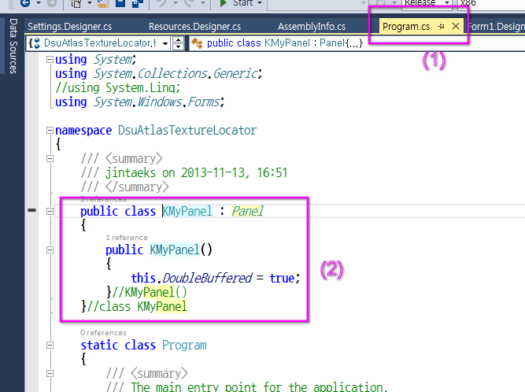
Tip. Apply a DoubleBuffered property to the panel in C#
To remove flickering of a panel drawing, we can set 'DoubleBuffered' property to true.
If we do this, the built-in Form editor in Visual Studio 2010 doesn't work.
To resolve this, we can write a code in separate .cs file which uses same namespace.

Slide 13
Making Face Arrange Plugin for 3dsMax

Slide 14
Failure cases of UV face breaking.
When all UV vertices are located in one point.
Too many face breaking by unspecified UV values.
Faces which comprise a one polygon is flipped to each other.
Different geometry face shares a same UV face.
The number of geometry faces and UV faces are not match.
Because UV faces are shared.
A material is not exist for specific material Id.

Slide 15
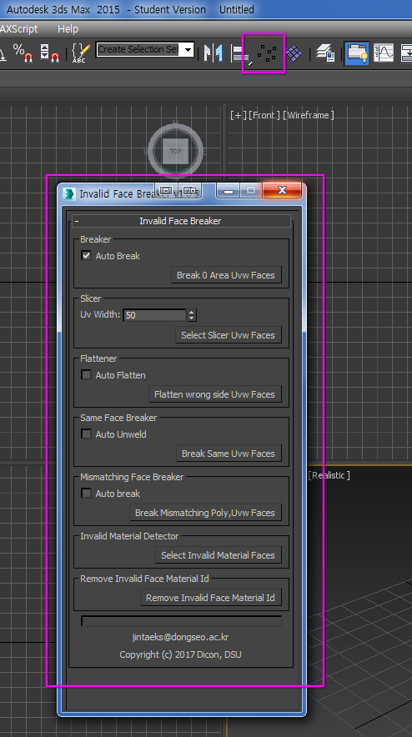
Invalid Face Breaker Plugin
(1) Select a icon in the main toolbar.
(2) There is a button for each feature.

Slide 16
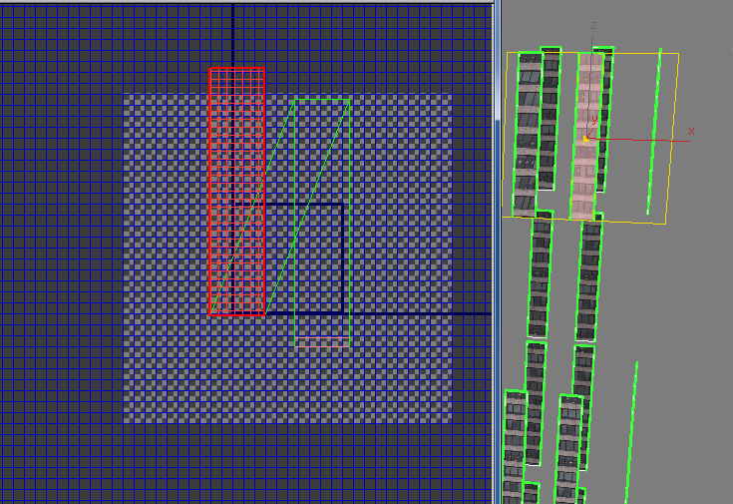
Ex) Break Mismatching Poly, Uvw Faces

Slide 17
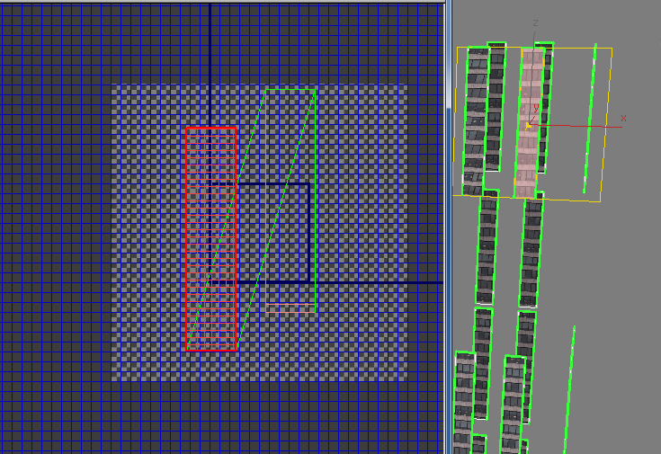

Slide 18
Hurdles in MaxScript Coding

Slide 19
When padding is too small, Atlas image is slightly shifted to upward.
Maybe innate 3dsMax Script errors, resolved by using alternative equations.
-- move uvs
local move_x = ((m_bitmaps[bmp_id].x + uvMoveWidth + tp) as float) / (size_of_texatlas_x as float)
/** fixed critical bug.
@note don't use like below.
maybe numerical rounding error.
@date jintaeks on ¿ÀÈÄ 10:19 2013-11-29
local move_y = 1.0 - ((m_bitmaps[bmp_id].y + uvMoveHeight + tp) as float) / (size_of_texatlas_y as float)
uvwmod.moveSelected [move_x, move_y, 0.0]
*/
local move_y = ((m_bitmaps[bmp_id].y + uvMoveHeight + tp) as float) / (size_of_texatlas_y as float)
uvwmod.moveSelected [move_x, 1.0 - move_y, 0.0]

Slide 20
System memory is increasing after moveSelected() call
if false then
(
uvwmod.moveSelected [x_move, y_move, 0.0]
)
else
(
/** fixed big memory increase problem of 'uvwmod.moveSelected'
- jintaeks on ¿ÀÈÄ 2:33 2013-12-03 */
uvwmod.faceToVertSelect()
local vertIndices = ( uvwmod.getSelectedVertices() ) as Array
local numIndices = vertIndices.count
-- local vertices = #()
local vertTemp = [0, 0, 0] as point3
for vindex in vertIndices Do
(
vertTemp = (uvwmod.getVertexPosition 0 vindex)
vertTemp.x += x_move
vertTemp.y += y_move
--append vertices vertTemp
uvwmod.setVertexPosition 0 vindex vertTemp
)--for
)--if.. else..
If the geometry is complex, the system memory will be increased by 1Giga byte after the task.

Slide 21
Demo

Slide 22




